Slide 1
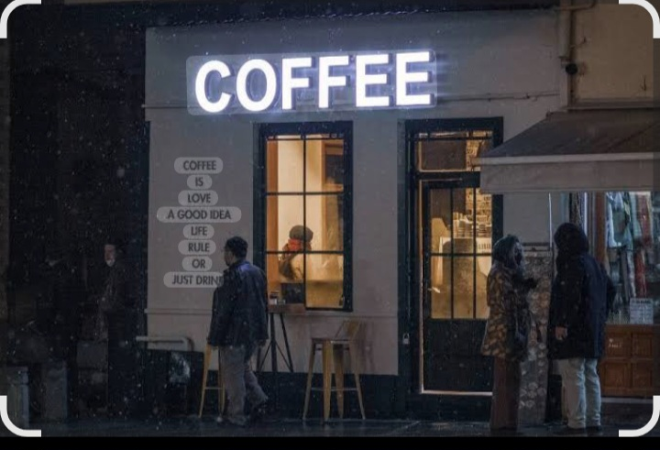
Bright Coffee Shop

Slide 2
Table of content
Table of content………...........…………………..2
Miro Planning……………………………………….3
MYSQL……………………………………………………5
Gloogle lookerstudio………………………………..6
Recommendations……………………………………10

Slide 3
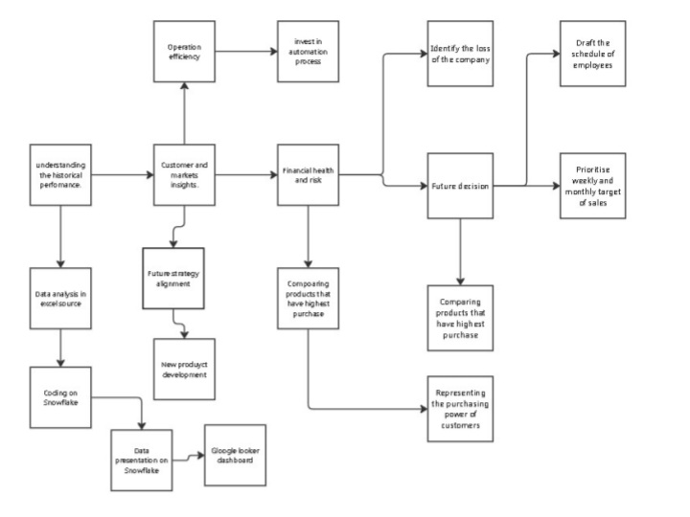
Miro Planing

Slide 4
On Miro we have to understand the historical performance which helps the management and CEO to understand clearly about their organisation`s past. Customer and markets insights ,here the company have to understand better their target market to maximize more sales and develop new strategies that align with their customers .Financial health and risk, here the company have to prioritize their decisions to achieve their firm`s objective

Slide 5
MY SQL
On SQL our syntax/queries show preparations of counting the number of sales we made and understanding to categorize the time slots of our customers due the their buying power, differentiating their transaction date and time also days to have better understanding of product they buy the most. We also splited the time by morning , afternoon, evenning and night to see which time of the day we get busy the most.

Slide 6
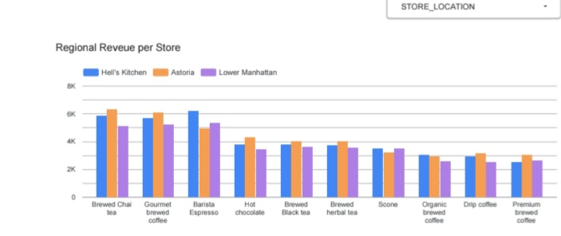
Google Looker

Slide 7
The explanation of the graph
The above graph represent the regional revenue per store. Now we can which store is able to make target of sales per product type ,
On this graph we have Hell`s Kitchen which has the highest bars among other stores and is followed by Astoria store and Lowe manhattn is the last in meeting the sales target.
Now the CEO will be able to know where to make changes since the store are not equal in meeting the sales target therefore marketing strategy is required on the Lower manhattan to meet targeted revenue.

Slide 8
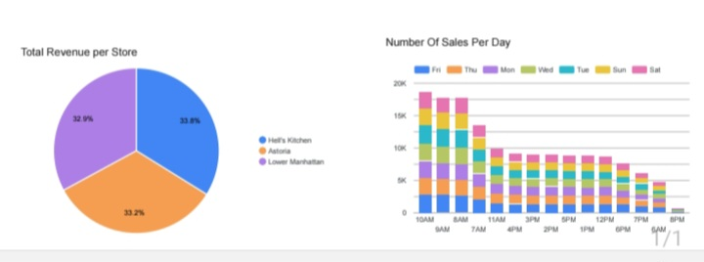
The below pie chart represent the total revenue made by each store now we can see that Hell`s kitchen made 33,8%, Astoria made 33,2% and Lower manhattan made 32,2%.

Slide 9
Explanation for above bar graph
The above single bar graph represent the number of sales per day. As we can see that at morning Stores made a lot of sales, then afternoon sales start decreasing until 7:30 pm. According to my observation the Stores should close at 7:30 pm since they are no longer making sales at 8 pm.

Slide 10
Recommendations
Our report gives a clear understanding to the CEO and Management as we can see on these graphs the performance of each store and the the type of product that is the most targets to the customers, also the purchasing power of customers per day tells us when to open the store and when to close. Now the CEO has to take a proper future decision that aligns with the firm`s objective in maximization of revenue.

Slide 11
THANK YOU…

